Slide 1
Greenbrook - Back to School Night
2018-19

Slide 2
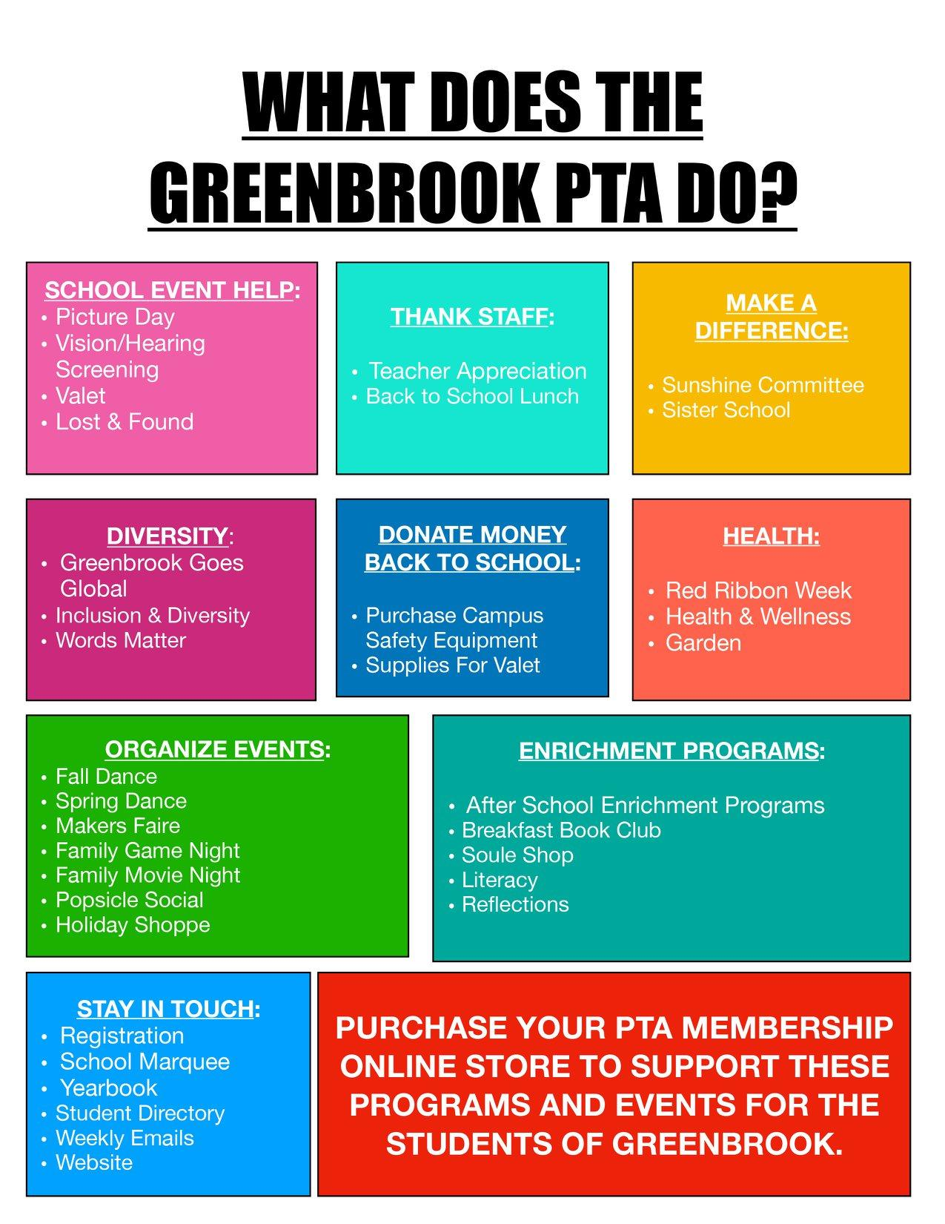
EAGLE
Greenbrook’s fundraising body - - termed “Education Foundation” We pay for people, programs, and student devices around campus!
EAGLE is an affiliate of San Ramon Valley Education Foundation
We need to raise $260,000 this school year to cover our costs associated with programs and staff: general music teacher for primary grades, technology support, classroom paraeducators, art, math intervention, reading intervention, librarian and more!
We rely on family donations to make up 50% of our annual costs and we fundraise for the other 50%.
You can make a family donation to Eagle through our registration: https://greenbrook.futurefund.com/registration

Slide 3
Hot Topics: Student Safety First!
Please be aware of our drop-off and pick-up procedures:
http://gbes-srvusd-ca.schoolloop.com/dropoffpickup
**Students are not allowed to come unto campus until 8:20 a.m. as that is when we have adult supervision
Please pack a “nut-free” snack for morning snack recess - - we have several students with severe nut allergies which require epipens on campus. Please remind your students to wash their hands after breakfast.
District policy allows for 3 “food parties” per year. The classrooms typically have parties for Halloween, winter break, and end of the year. Classrooms with students with allergies will make sure all food items are nut-free and inclusive for all.
Please do not bring birthday treats or food to school
Please do not bring birthday gifts or favors to school

Slide 4
Our Students SOAR!
Greenbrook School Rules

Slide 5
Volunteering on Campus and/or Field Trips
Be a Mentor
Noon Duty Supervision
We are always looking for parents to help with lunch and lunch recess! If you are able to help out - - even if it is just here and there, please email Meghan Felardo: mfelardo@srvusd.net
We have two trainings already scheduled:
Noon Duty Training - Procedures (MPR)
Wednesday, August 29th: 8:45-10:00 a.m.
Conflict Mediation Training (by Soul Shoppe)
Friday, September 14th: 8:45-10:00 a.m.
Be a School Volunteer!
You need to have Level 1 clearance to volunteer on campus
Level 2 to drive on Field Trips
Level 3 to chaperone overnight trips: Outdoor Ed/Camp Arroyo

Slide 6
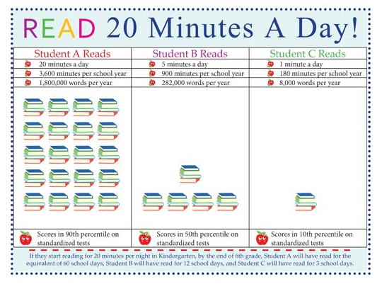
Homework Policy
District & Greenbrook Homework Policies
ELEMENTARY SCHOOL HIGHLIGHTS:
No homework over weekends or holidays (exception is reading)
K/1: no more than 30 min. of homework/night (reading included)
2nd/3rd: no more than 45 min. of homework/night (reading included)
4th/5th: no more than 1 hour of homework/night (reading included)

Slide 7
Please follow us on Twitter!
@greenbrookk5
“Like” the Parent of Greenbrook Facebook Page!
http://gbes-srvusd-ca.schoolloop.com/cms/page_view?d=x&piid=&vpid=1229222740004

